Slide 1
Writing stories
by Perepelyak Tatyana

Slide 2
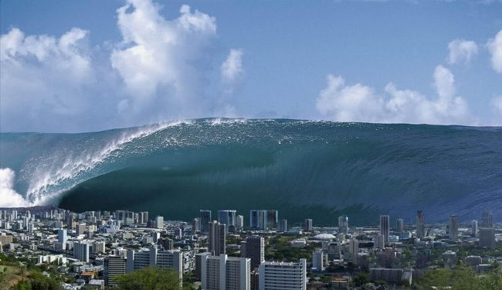

Slide 3
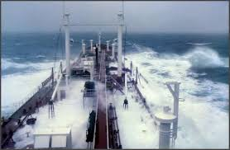
An Amazing Rescue

Slide 4
1. Which paragraphs sets the scene? How?
2. What is the climax event and what happened before it?
3. How does the story end?
4. How does the writer begin/end story in an interesting way?

Slide 5
Linking Words
First/ at first
Then/ next
After/ before
Finally/ in the end/ evedentually
Within seconds/ immediately
No sooner … then/ hardly … when
Just as …, while, by the time …

Slide 6
Which tense do we use to give background information?
A past simple B past continuous C past perfect
Which paragraphs make up the main body of a story?
A 1 & 2 B 3 & 4 C 2 & 3
Which paragraph describes the main event?
A the third B the second C the first
Which paragraph sets the scene?
A the second B the third C the first
What do we use to make the description more vivid?
A repetition B senses C much violence
We never end a story by…
A writing the END at the bottom of the page
B creating mystery or suspense
C describing people’s feelings

Slide 7
Narrative techniques
complex adjectives and adverbs
avoiding simple verbs
use of senses
alliteration
metaphors/similes
participles
hyperbole
feelings

Slide 8
Hometask
SB p. 76 Ex. 16; WB p. 33 ex. 4.

